Slide 1

The Influence of Harry Potter on the Young Generation
Colegiul National “I. M. Clain”, Blaj
Atestat Profesional la Limba Engleza
Propunator: Mihu Cristiana-Maria
Indrumator: Prof. Munteanu Dinora Iunia
Blaj, 2022

Slide 2
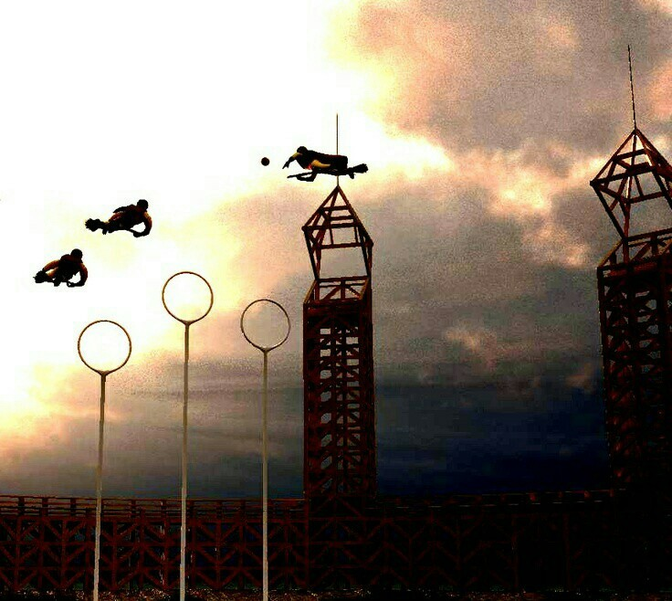
Description
The Harry Potter series is a story about friendship and courage where there are beloved and admired teachers and fantastic creatures that the little ones dream of. Psychologists claim that both children and adults escape from reality through the fantastic.

Slide 3
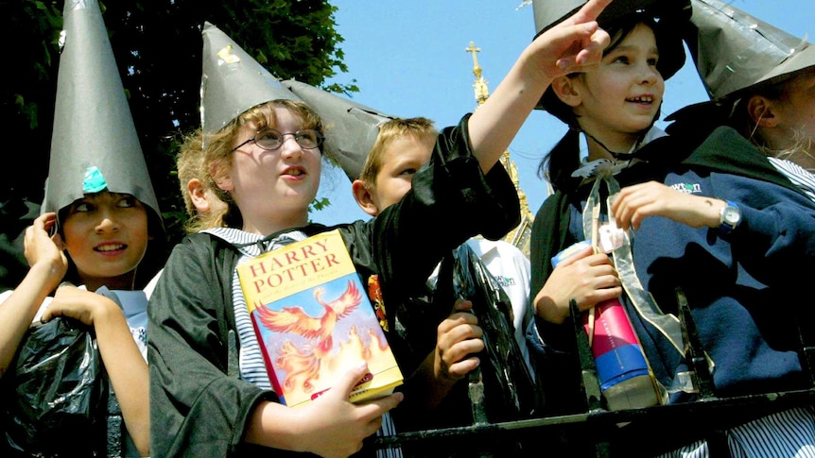
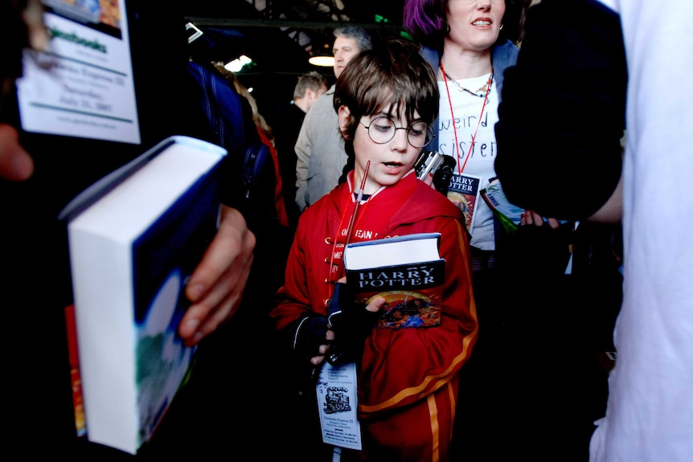
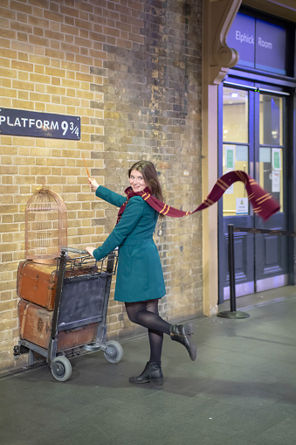
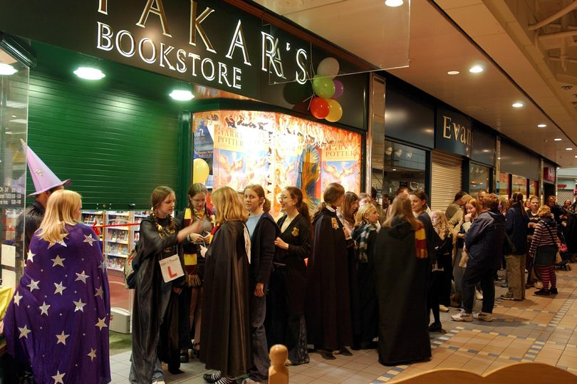
The Impact of Harry Potter. Harry Potter phenomenon
It all started from 7 books, that would change everything!
The success of the series of volumes signed by J.K.Rowling is a clear proof of the exceptional appetite of the contemporary individual - adult or child - for any kind of magical intrusion into everyday life but also of an aggressive cultural marketing.

Slide 4
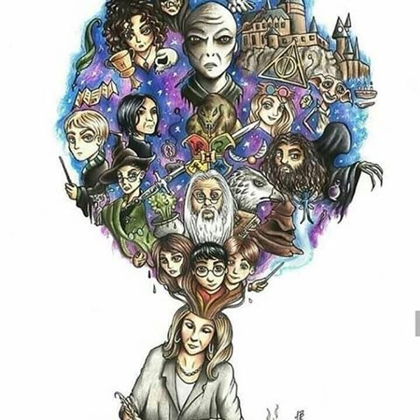
J.K.Rowling
The world of Harry Potter is an unimaginable thing created by just a simple author: J. K. Rowling. A simple woman, who surpassed the highest peaks of imagination, creating creatures, even inteligent ones, with their own name, different and unique spells, gret witches and wizards and an beautiful, yet scary world for a somple mortal.

Slide 5
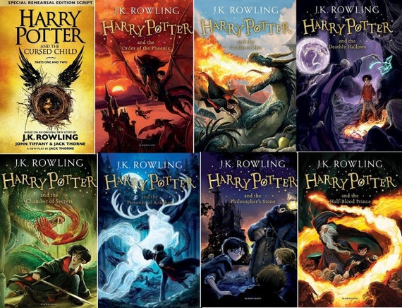
Harry Potter volumes, a series of seven fantasy novels:
1.Harry Potter and the Philosopher‘s Stone - June 30, 1997
2.Harry Potter and the Chamber of Secrets - July 2, 1998
3.Harry Potter and the Prisoner of Azkaban - July 8, 1999
4.Harry Potter and the Goblet of Fire - July 8, 2000
5.Harry Potter and the Order of the Phoenix - June 21, 2003
6.Harry Potter and the Half-Blood Prince - July 16, 2005
7.Harry Potter and the Deathly Hallows - July 21, 2007
8.Harry Potter and the Cursed child
8-Film Collection:
1.Harry Potter and the Sorcerer's Stone
2.Harry Potter and the Chamber of Secrets
3.Harry Potter and the Prisoner of Azkaban
4.Harry Potter and the Goblet of Fire
5.Harry Potter and the Order of Phoenix
6.Harry Potter and the Half-Blood Prince
7.Harry Potter and the Deathly Hallows - Part 1
8.Harry Potter and the Deathly Hallows - Part 2

Slide 6
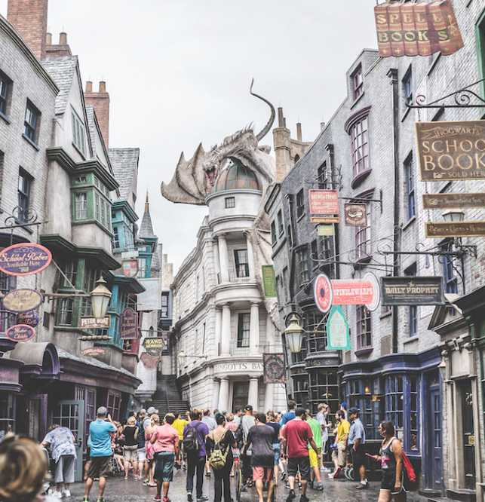
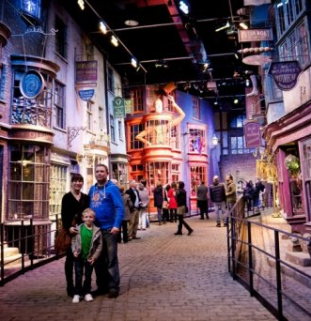
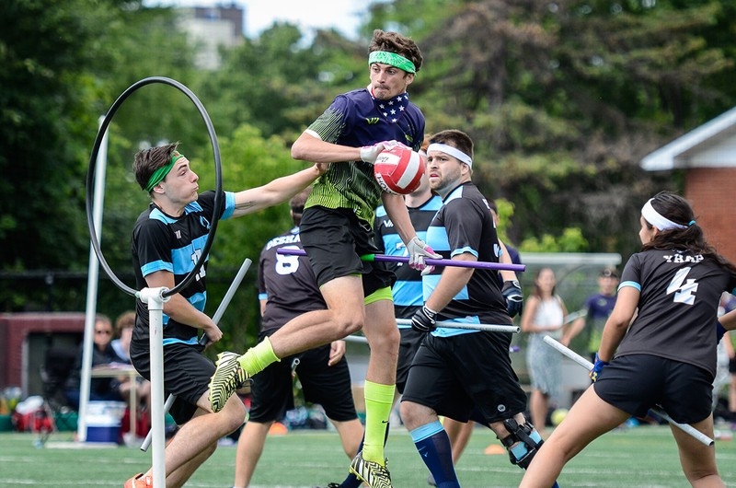
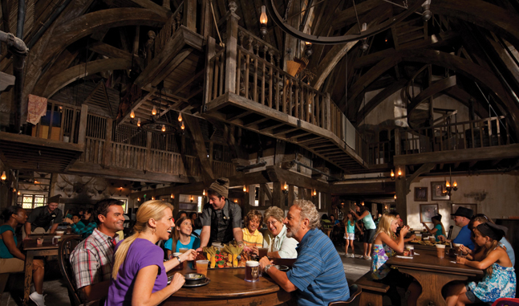
Because of the large number of Harry Potter fans, people have set up places in various countries to visit just like the ones found in Harry Potter movies, souvenir shops, theme parks, cafes and Harry Potter-themed restaurants, an international sporting competition and even a music genre all dedicated to the series.

Slide 7
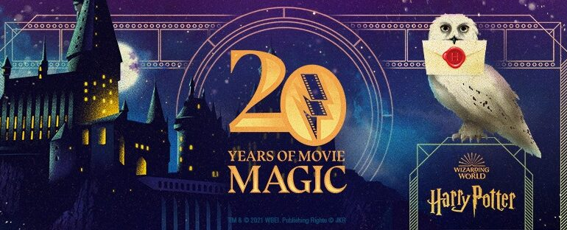
The future of Potterheads. The 20th Anniversary
It's been a long time since Harry Potter and the Deathly Hallows. However, far from falling into oblivion or nostalgia. We do not know what the future holds, but everything seems to indicate that this fandom is more alive than ever.
The first "Harry Potter" movie was released in the United States on November 16, 2001. And so it has been 20 years since the first Harry Potter movie was released and special events are taking place or are being prepared everywhere.

Slide 8
Webliography:
https://ro.larafornm.com/harry-potter-fandom-an-extraordinary-phenomenon
https://www.clubuldecultura.ro/de-ce-il-iubesc-copiii-pe-harry-potter
https://www.abc.net.au/news/2017-06-26/harry-potter-effect-how-seven-books-changed-childrens-publishing/
https://www.google.com/amp/s/adevarul.ro/sanatate/minte-sanatoasa/ce-efect-surprinzator-harry-potter-asupracopiilor/

Slide 9

THANKS FOR YOUR ATTENTION

